Slide 1

Advanced computer networks
Course Instructor: S Nagasundari

Slide 2
Choose Advanced Computer networks
If you
want to choose your career in Networks with good package?
Top Networking companies..
interested to do Certifications in Networking?
Comptia Network+, CCNA, CCNP,…
are interested to get a feel of Research in Networks
Intent based Networking, Multi domain Control, Virtual Networking
simply interested to learn deep into networks

Slide 3
Learning Advanced Computer networks is interesting…
Understanding through Analysis and practical implementation
Working in Network Design Projects assisted with lab exercises
Experiment and realize network design using tools and simulations

Slide 4

About Professor
S Nagasundari
Associate Professor
Faculty Member of C-IoT and C-ISFCR
Department of Computer Science
PES University
Contact
Email : nagasundaris@pes.edu
Desk : B-203D13, Second floor, B Block
Research Interest
Design of Cyber Physical Systems
SCADA system Security
Intent based Networking

Slide 5
Forms of Teaching
Lectures
Lab Exercises
Project
Case Study/Seminars/Discussions
Quiz/ISA/ESA Exams

Slide 6
Course objectives
Develop a strong understanding of network by
Analysing the network traffic and working of applications and protocols.
Designing the network for a given system using top down approach.
Deep dive into practical approach to implement the designed network specifying the addressing mechanism and routing strategy
Unearth research contributions required in networks

Slide 7
Course outcomes
Given a scenario, you are equipped to
Design a network satisfying the customer requirements
Experiment the network design using simulation environment
Realize the utilization of routing protocols according to the given constraints
Troubleshoot the network design issues

Slide 8
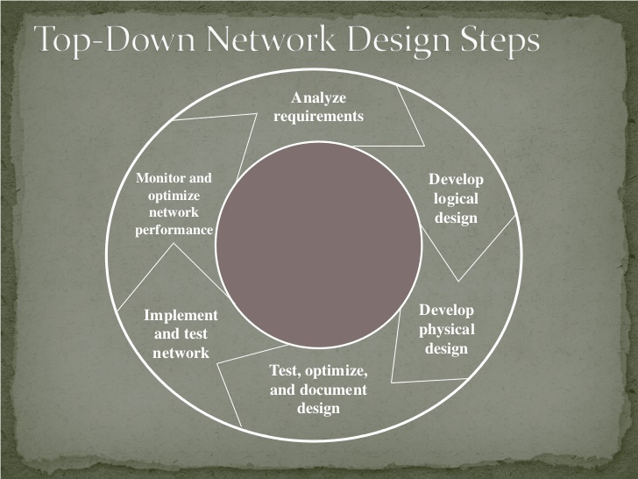
Course outline
Unit 1:
Identifying Customer’s Needs and Goals

Slide 9
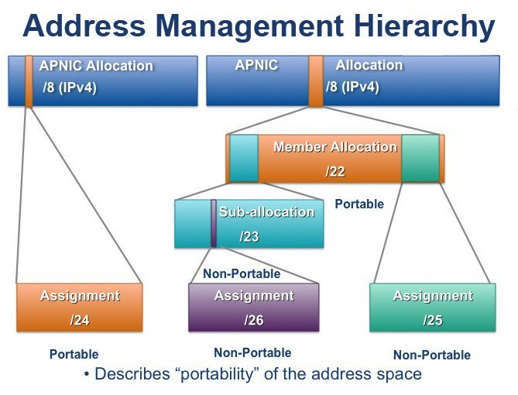
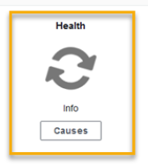
Course outline
Unit 2:
Characterizing the Existing Internetwork and Network Traffic
Unit 3:
Logical Network Design I

Slide 10
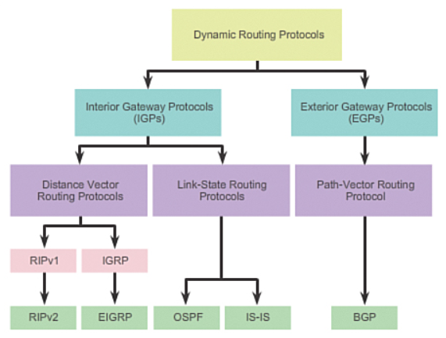
Course outline
Unit 4:
Logical Network Design II

Slide 11
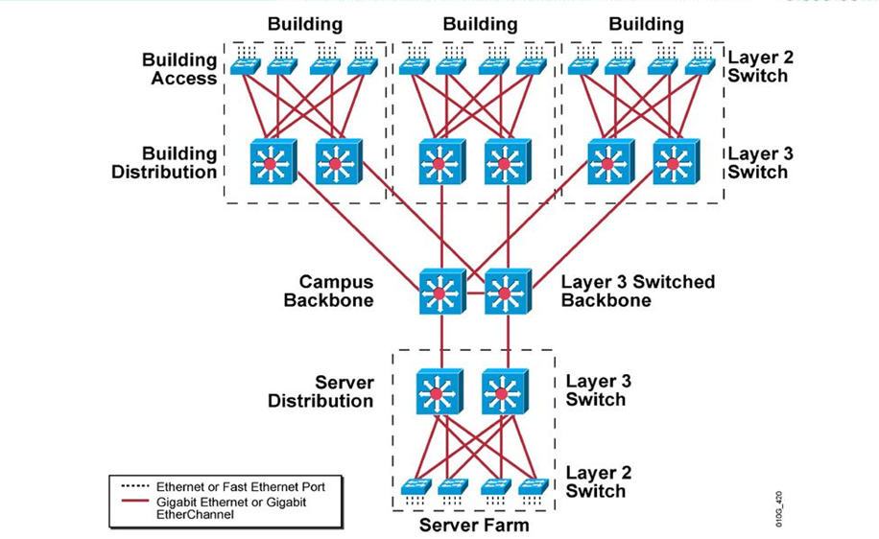
Course outline
Unit 5:
Physical Network Design

Slide 12


Course outline
Tools :
Claynet
Cisco Packet Tracer

Slide 13
Course Grading policy*
Component | Marks
ISA 1 | 10
ISA 2 | 10
Lab exercises | 10
Project | 20
Internal Assessment | 50
End Semester Assessment | 50
Total (ISA + ESA) | 100
* Tentative

Slide 14

References
Text Book:
Top-Down Network Design, Priscilla Oppenheimer, Cisco Press, 3rd Edition, 2011.
Reference Book(s):
Modeling and Tools for Network Simulation, KlausWehrle, Mesut Günes and James Gross, Springer, 2010.
Networking Systems Design and Development, Lee Chao, CRC Press, 2009.
The Practice of System and Network Administration, Thomas A. Limoncelli, Christina J. Hogan and Strata R. Chalup, Addison-Wesley Professional, 2016.

